Slide 1
iMet Collection 2019 – FGVC6
Recognize artwork attributes from the metropolitan museum of arts

Slide 2
Outline
Competition Overview
The Problem
The Search of a Solution
Final Remarks

Slide 3



Competition Background
Host: FGVC6 – the sixth workshop of Fine-Grained Visual Categorization at CVPR 2019
Partner: The Metropolitan Museum of Arts in New York
Subject: The MET’s collection

Slide 4
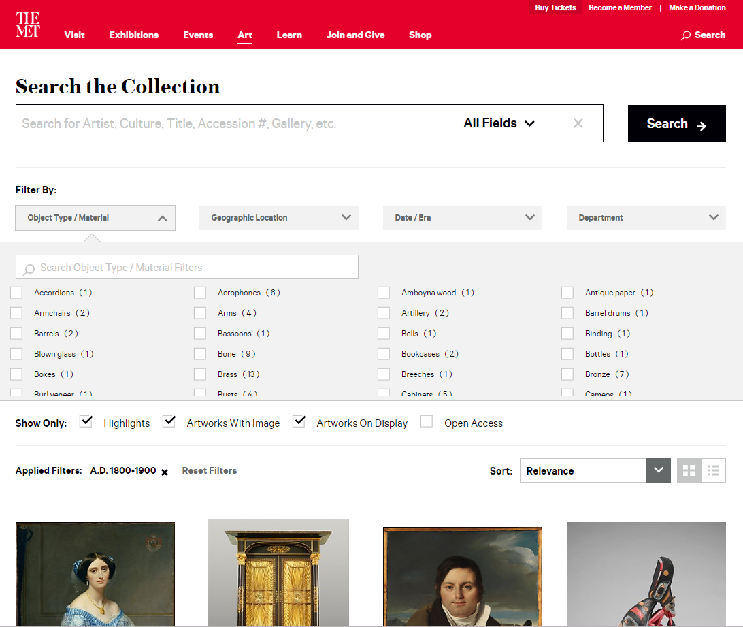
The Met’s Collection
1.5M Objects
Paintings, sculptures, historic artifacts, furniture, photos, prints, stained glass windows, jewelry, a patio, etc.
200K with digital imagery
Online catalog available at https://www.metmuseum.org/art/collection

Slide 5
The Problem
What are we trying to solve?

Slide 6
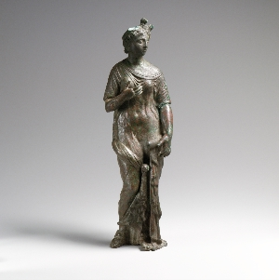
Problem Statement
Given the photo of an artifact, can you identify its attributes?
Look at my fancy hat!
I am probably Greek.
I think I may be a goddess.
Could be Roman?

Slide 7
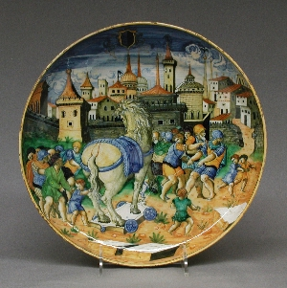
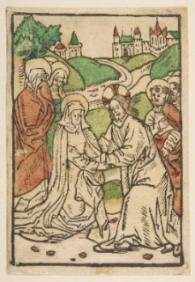
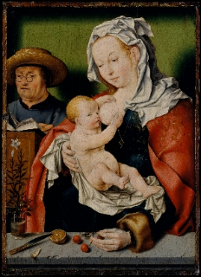
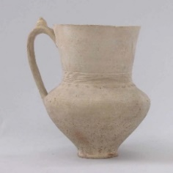
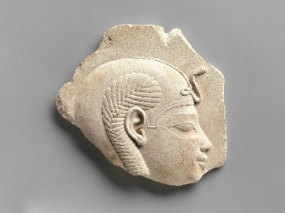
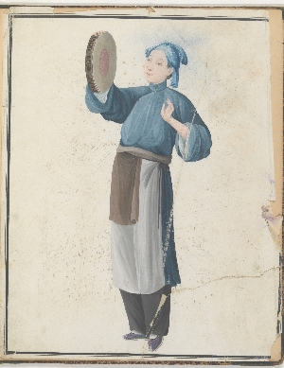
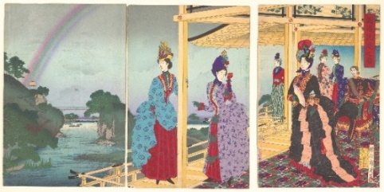
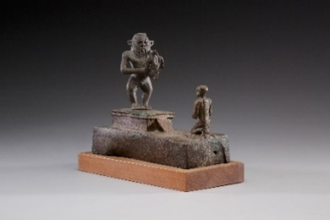
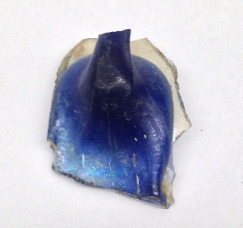
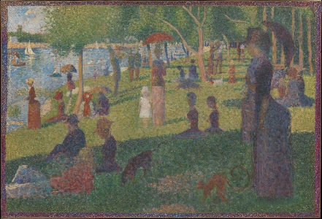
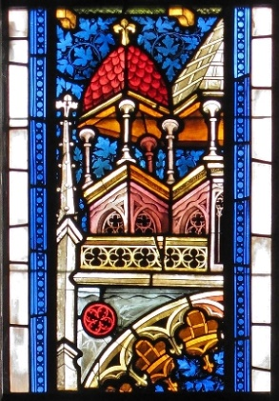
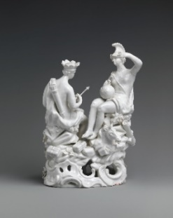
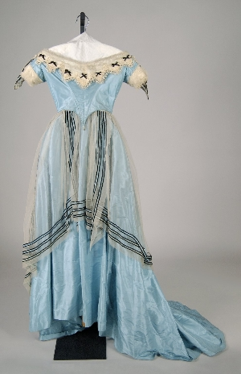
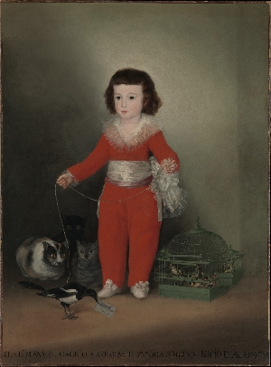
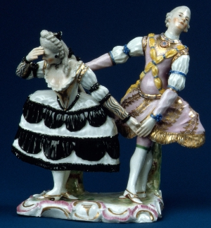
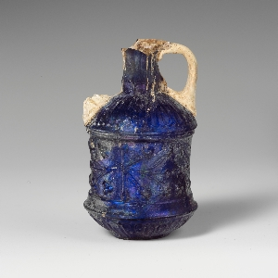
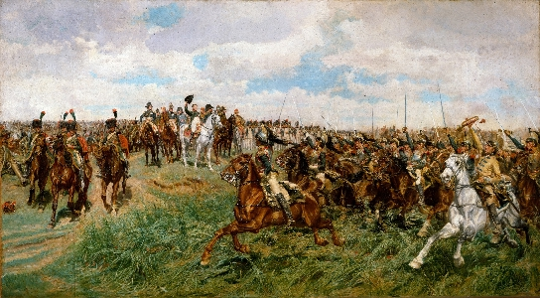
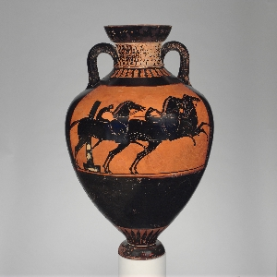
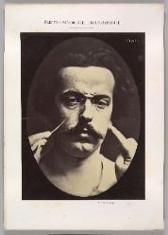
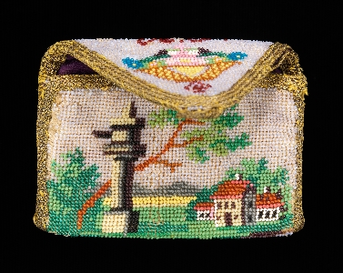
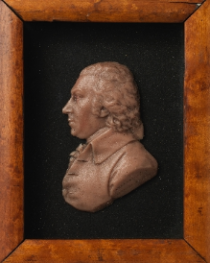
Training Data
109237 images
1103 labels
2 categories of labels, culture and tag

Slide 8
Exhibit A
culture::Egyptian
tag::goddess
tag::Aphrodite
tag::hats
tag::sculpture

Slide 9
Exhibit B
culture::Italian
tag::dishes
culture::Urbino
tag::horses
tag::children
tag::men

Slide 10
The Labels
398 culture labels
705 tag labels
culture::attic
tag::cameos
culture::atlantic watershed
tag::daily life
culture::laconian
tag::athena
culture::american
tag::fairies
culture::edomite
tag::tea caddy
culture::italian or spanish
tag::drunkenness

Slide 11
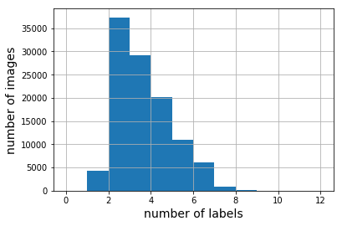
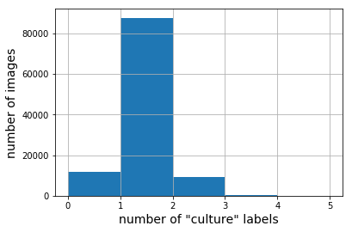
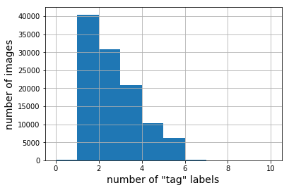
Labels Per Image
An image could have
1 to 11 any labels
0 to 4 culture labels
0 to 9 tag labels

Slide 12
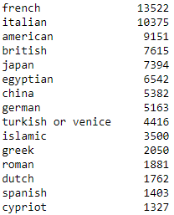
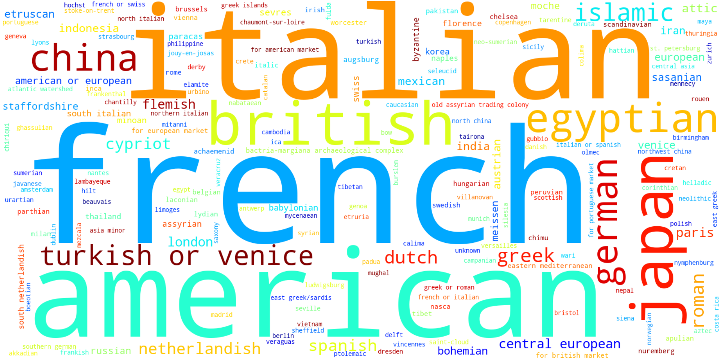
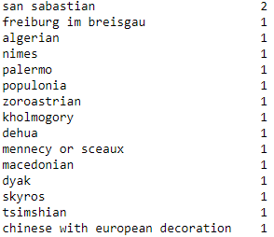

Culture Labels Frequency
$$⋯$$

Slide 13
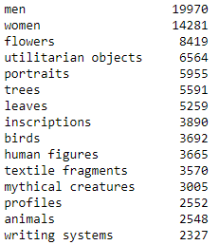
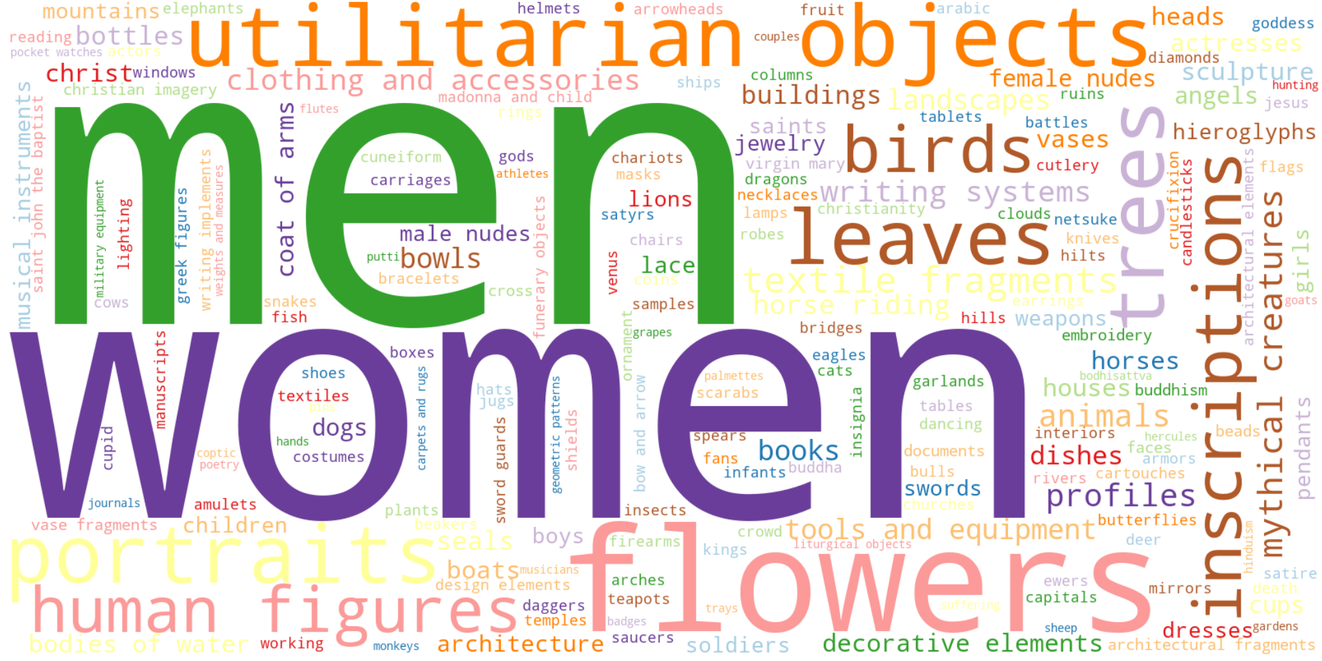
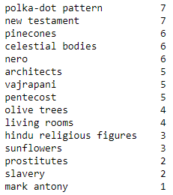
Tab Labels Frequency
$$⋯$$

Slide 14
Problem Formulation
A multi-label classification problem
Model
culture::Urbino
Fine-grained attribute recognition
culture::Italian
tag::dishes
tag::horses
Multiple objects recognition
tag::men
tag::children

Slide 15
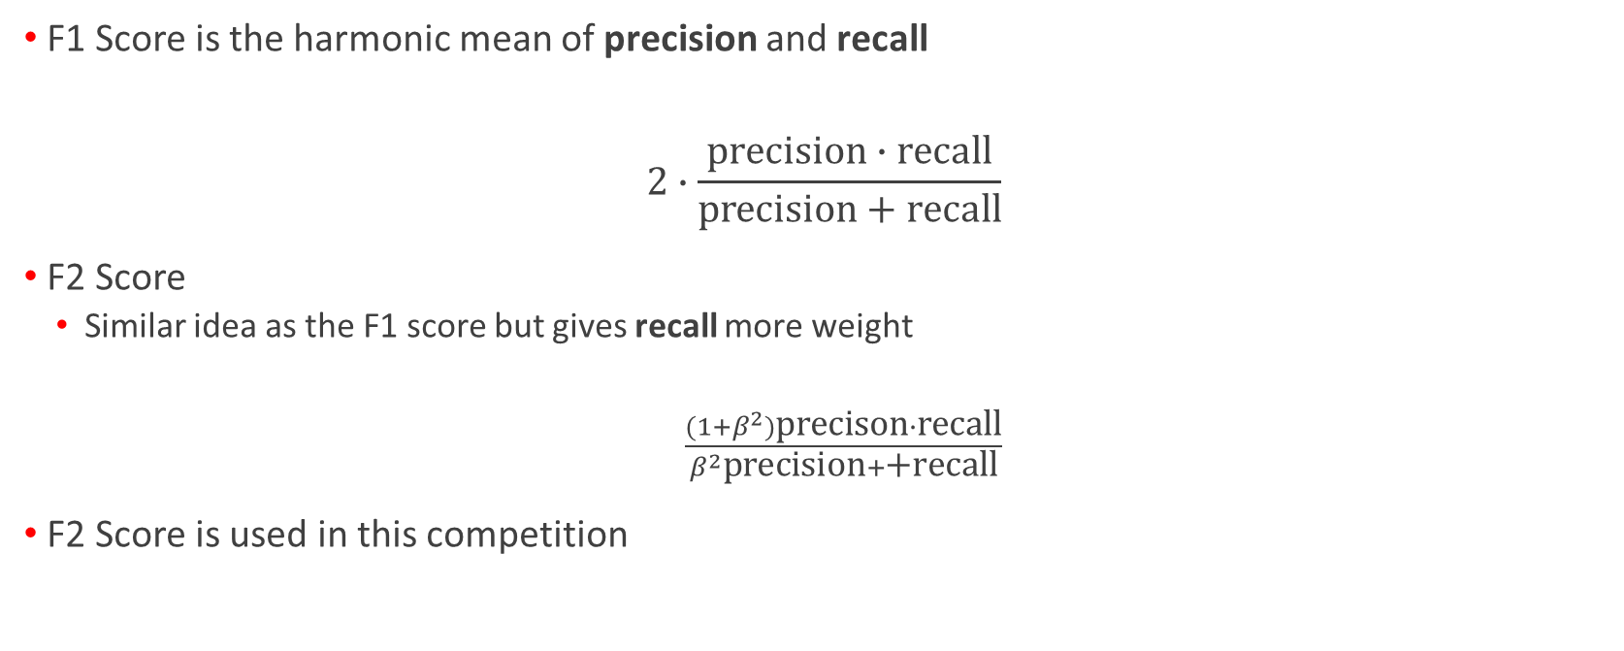
Evaluation
F1 Score is the harmonic mean of precision and recall
$$2∙\frac{\text{precision}∙\text{recall}}{\text{precision}+\text{recall}}$$
F2 Score
Similar idea as the F1 score but gives recall more weight
$\frac{(1+β^{2})\text{precison}∙\text{recall}}{β^{2}\text{precision}+\text{+}\text{recall}}$
F2 Score is used in this competition

Slide 16
The Search of a Solution
A deep learning approach

Slide 17
A Typical Pipeline to Train a Model for Image Classification Problem
Data Augmentation
Generate more images
Train the Zoo
Muster the power of pre-trained networks
Build a stacked model
Consolidate everything

Slide 18
Data Augmentation
Generating more images by
shifting in x and y direction (translation)
rotation
zooming in and out
changing brightness
“In the real-world scenario, we may have a dataset of images taken in a limited set of conditions. But our target application may exist in a variety of conditions, such as different orientation, location, scale, brightness etc. We account for these situations by training our neural network with additional synthetically modified data.” - https://medium.com/nanonets/how-to-use-deep-learning-when-you-have-limited-data-part-2-data-augmentation-c26971dc8ced

Slide 19
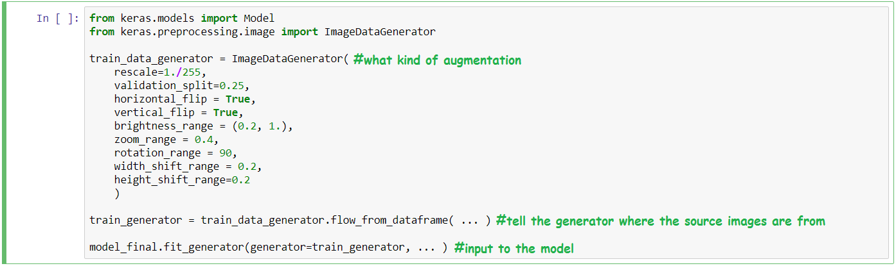
Data Augmentation with Keras

Slide 20
Train the Zoo
Choose a few pre-trained models (VGG16, ResNet, InceptionV3)
Modify by adding a few layers at the end (Transfer learning)
Train the modified models and use them for the ensemble

Slide 21
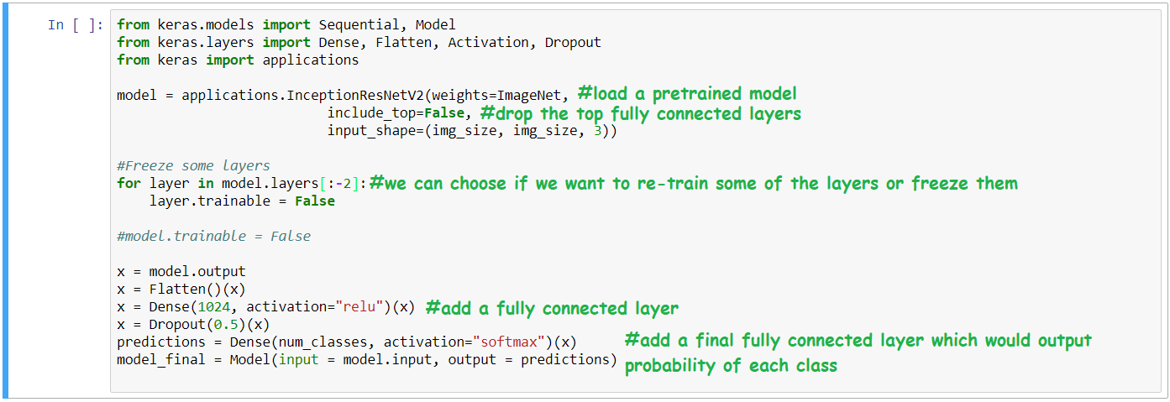
Transfer Learning with Keras

Slide 22
Focal Loss
The most commonly used loss function in this competition
A variation of binary cross-entropy
Give “easy” samples a smaller weight
Claim to alleviate the problem of class imbalance
A very good explanation of various loss functions - https://gombru.github.io/2018/05/23/cross_entropy_loss/

Slide 23
Transfer Learning Starter Code
https://www.kaggle.com/ateplyuk/keras-starter - score 0.488
https://www.kaggle.com/ratthachat/imet-resnet50-keras-starter - score 0.56
https://www.kaggle.com/mnpinto/imet-fastai-starter - score 0.545

Slide 24
Build a Stacked Model
Create a vector of extracted features including the probabilities of each model
Input the vector to a classifier, e.g. gradient-boosted tree

Slide 25
The Pipeline of the Winning Solution
Data Augmentation
Additional features
Train the Zoo
Re-train the models
Build a stacked model

Slide 26
Winning Solution – Train the Zoo
Models: SENet154, PNasNet-5, SE-ResNext101
Sample with logarithmic weight
1st iteration – drop images with very high prediction error, consider them noisy
Train the Zoo
2st iteration – apply pseudo labeling, add the most confident predictions to the training data
Models for tag labels only
Using the trained models as pre-trains, train for the tag labels only

Slide 27
Winning Solution – Build a Stacked Model
Probabilities from the base models
Additional features: brightness, min and max of each channel, etc. And predictions from ImageNet.
LGBM

Slide 28
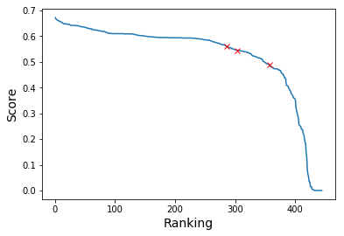
Final Remarks
Summary of the winning solution:
https://www.kaggle.com/c/imet-2019-fgvc6/discussion/94687#latest-570986 – score 0.672
× your score if you submit the starter code
To move up the leaderboard from starter code:
Careful data engineering
Better selection of pre-trained models
Popular choices: PNasNet-5, SE-ResNet101
Use ensemble model
Hyper-parameters tuning (requires good hardware)

